Slide 1
REST API

Slide 2
What is REST?
REpresentational State Transfer
Architecture Style for designing networked applications
Uses HTTP protocol for Communication
Treats server objects as resources that can be created or destroyed. (resources are accessed through URIs)

Slide 3
WHY REST?
REST demands the use of hypertext, which scales very well since the client and server are very loosely coupled
REST API is always independent of the type of platform or languages
REST protocol totally separates the user interface from the server and the data storage
allows the different components of the developments to be evolved independently.

Slide 4
REST ARCHITECTURAL CONSTRAINTS
CLIENT-SERVER
STATELESS
CACHEABLE
LAYERED SYSTEM
CODE-ON-DEMAND(OPTIONAL)
UNIFORM INTERFACE

Slide 5
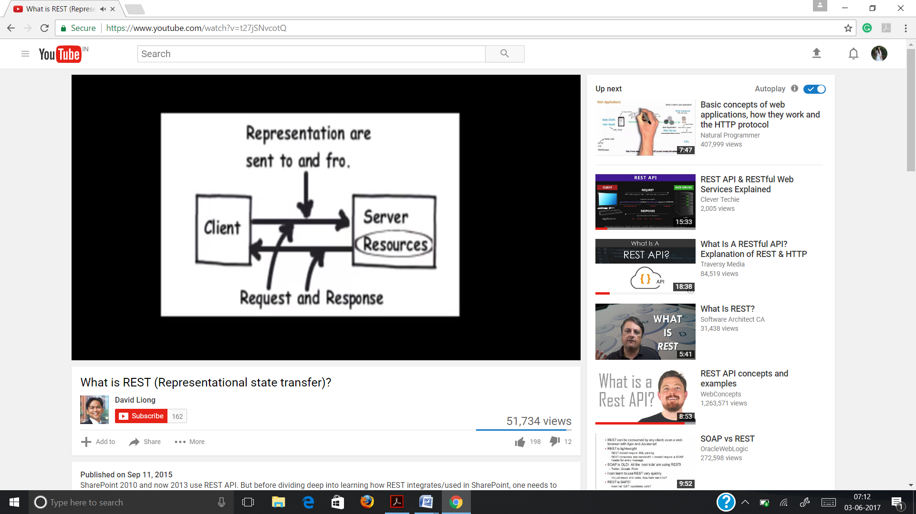

Slide 6
Client requests are made to a resource’s URI
Uniform Resource Identifier (URI) is a string of characters used to identify a resource.
Server responses of REST APIs can be delivered in multiple formats (JSON,XML)
JSON (JavaScript Object Notation) is a commonly used format for these responses
The resource may provide hypertext links to other related resources or collections of resources

Slide 7
HTTP REQUEST METHODS
GET
GET method requests a representation of the specified resource.
Requests using GET should only retrieve data and should have no other effect
GET requests can be cached
DELETE
DELETE method deletes the specified resource

Slide 8
PUT
PUT method requests that the enclosed entity be stored under the supplied URI
If the URI refers to an already existing resource, it is modified
If the URI does not point to an existing resource, then the server can create the resource with that URI
POST
Submits data to be processed to a specified resource
POST requests are never cached

Slide 9
ADVANTAGES OF REST ARCHITECTURE
PERFORMANCE
SCALABILITY
RELIABILITY
PORTABILITY OF COMPONENTS
MODIFIABILITY OF COMPONENTS
VISIBILITY OF COMMUNICATION
SIMPLICITY OF A UNIFORM INTERFACE

Slide 10
REAL EXAMPLES OF REST API
Instagram
Instagram API allows your applications to retrieve user accounts, photos, tags and more
Gmail
Gmail API revolves around messages, labels, drafts and history
Other Examples include GitHub etc.

Slide 11
REFERENCES
https://openclassrooms.com/courses/build-your-web-projects-with-rest-apis/examples-of-rest-apis
https://openclassrooms.com/courses/build-your-web-projects-with-rest-apis/choosing-rest
https://www.quora.com/How-is-REST-useful

Slide 12
http://www.restapitutorial.com/
https://en.wikipedia.org/wiki/Representational_state_transfer
https://dev.twitter.com/rest/public
Picture Source-: https://i.ytimg.com/vi/t27jSNvcotQ/hqdefault.jpg?custom=true&w=336&h=188&stc=true&jpg444=true&jpgq=90&sp=68&sigh=S2YkrUhENjTW53_XRjVFTCElfRc

